Slide 1

MTS-417 Intro to Robotics LAB No. 1 Introduction to CoppeliaSim EDU
Fall 2025 – DE 44 MTS
Lab Prepared by:
LE Hamza Sohail
Department of Mechatronics Engineering, National University of Sciences and Technology, College of E&ME

Slide 2
Lab Ethics
Just be disciplined and respectful…
Discipline includes the following:
Time management
Respecting peers, staff, faculty, and everyone
Turning off computers at the end of Lab.
Participation is highly encouraged and Graded as well.
Eatables are not allowed in lab.

Slide 3
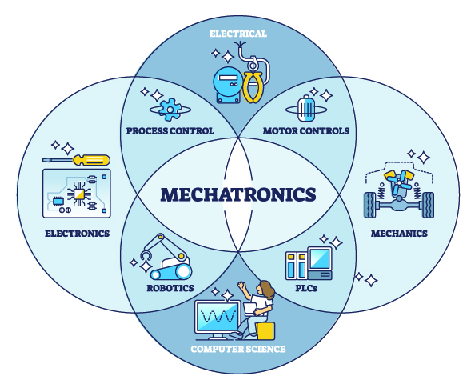
Mechatronics

Slide 4
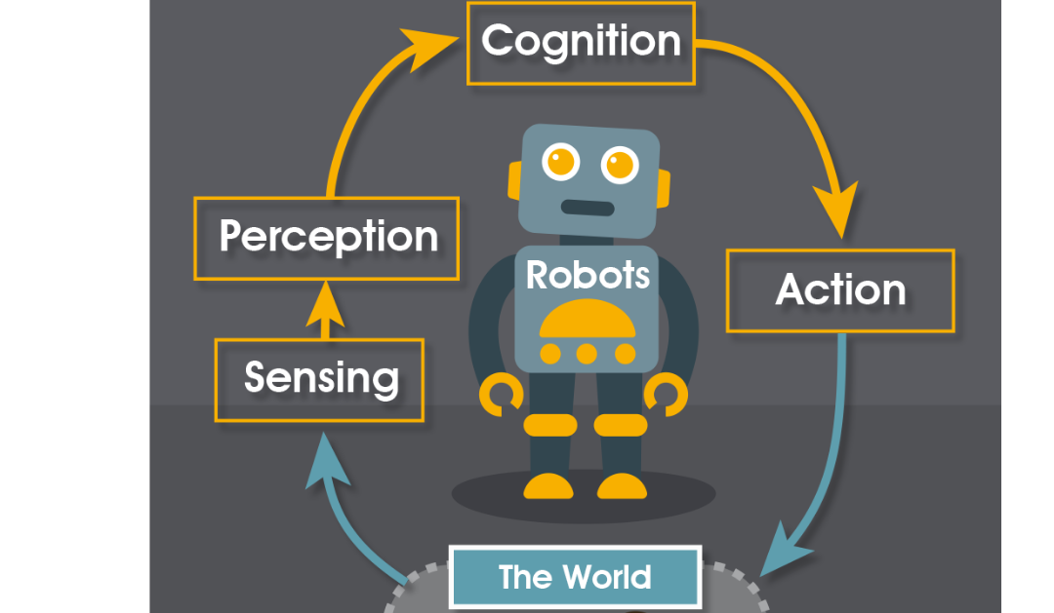
Robots

Slide 5
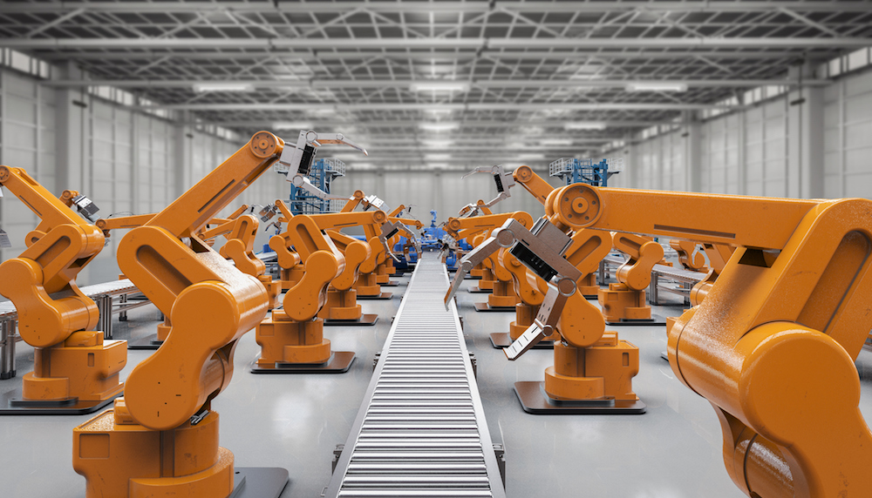
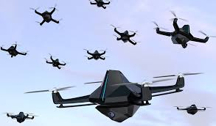
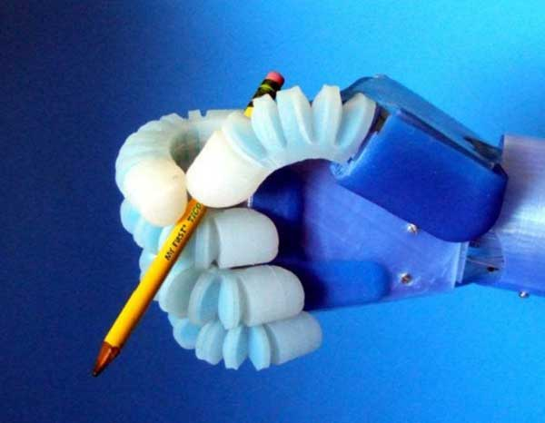
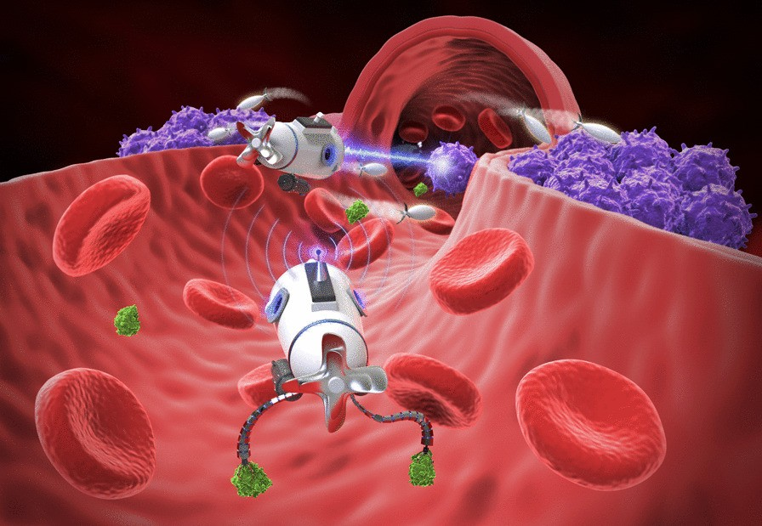
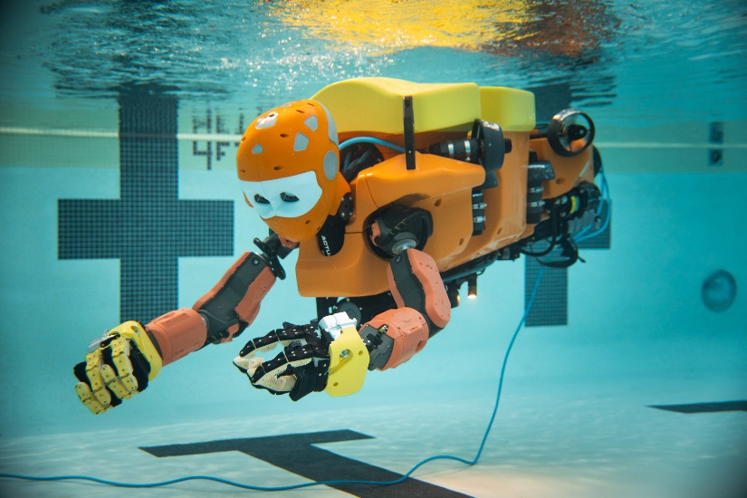
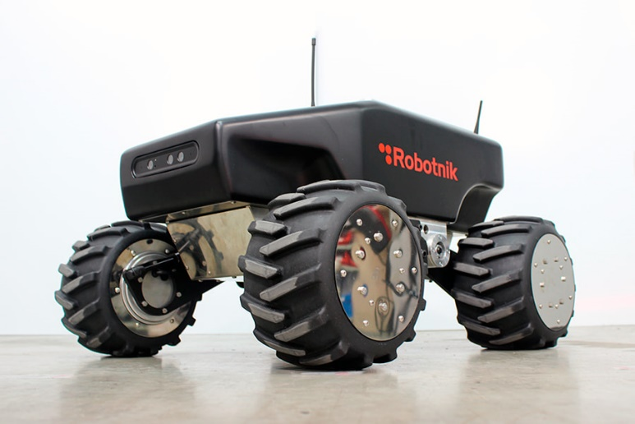
Fields in Robotics

Slide 6

Robot Operating Systems (ROS)

Slide 7

Linux vs Windows

Slide 8
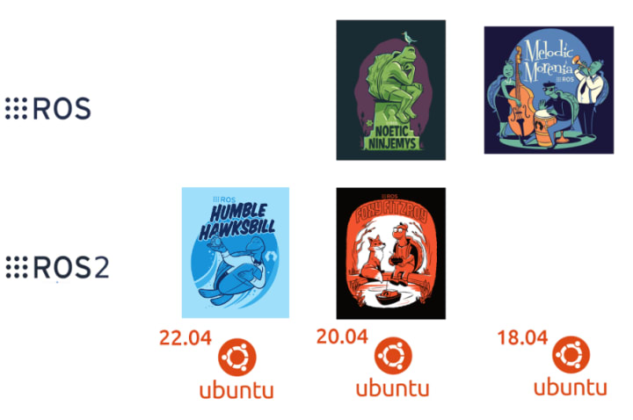
ROS Versions & Ubuntu

Slide 9
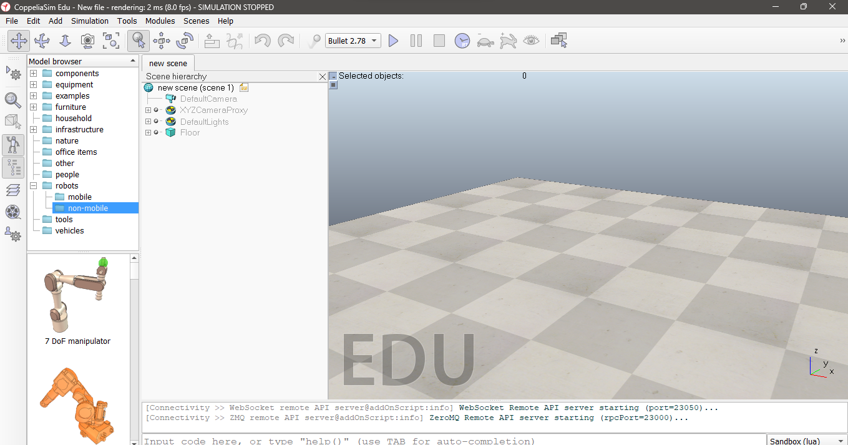
CoppeliaSim EDU Let’s Start ! ! !

Slide 10
Learning Objectives LAB 1
Understand CoppeliaSim EDU interface and scene hierarchy
Learn world vs local frame
Add, move, and simulate objects
Write and attach Lua child scripts
Move an object using a mathematical function
Introduce vector subtraction
Compute Euclidean distance between robot and goal
Use dot product to measure robot alignment with goal

Slide 11
Learning Objectives LAB 1
Relate linear and angular velocity to robot motion
See how equations define motion (linear, oscillatory, circular, spiral) and Implement these equations in CoppeliaSim EDU 4.7

Slide 12
Theory (World vs Local Frames)
World frame: fixed global reference
Local frame: attached to each object, moves with it
Robots operate in local frames; positions shown in world frame

Slide 13
COPPELIASIM EDU 4.7
Open CoppeliaSim 4.7 EDU
Add a cube, sphere, and cylinder; rename in Scene Hierarchy
Move, rotate, and scale objects
Run simulation and observe gravity

Slide 14
Linear Motion
Equation: x(t) = v · t
Insert a Cuboid
Attach a non-threaded child script
Modify script to move the cube with a sine function

Slide 15
Linear Motion
Equation: x(t) = v · t
function sysCall_init() cube = sim.getObjectHandle('Cuboid') end function sysCall_actuation() local t = sim.getSimulationTime() local v = 0.1 -- m/s local x = v * t sim.setObjectPosition(cube, -1, {x, 0, 0}) end

Slide 16
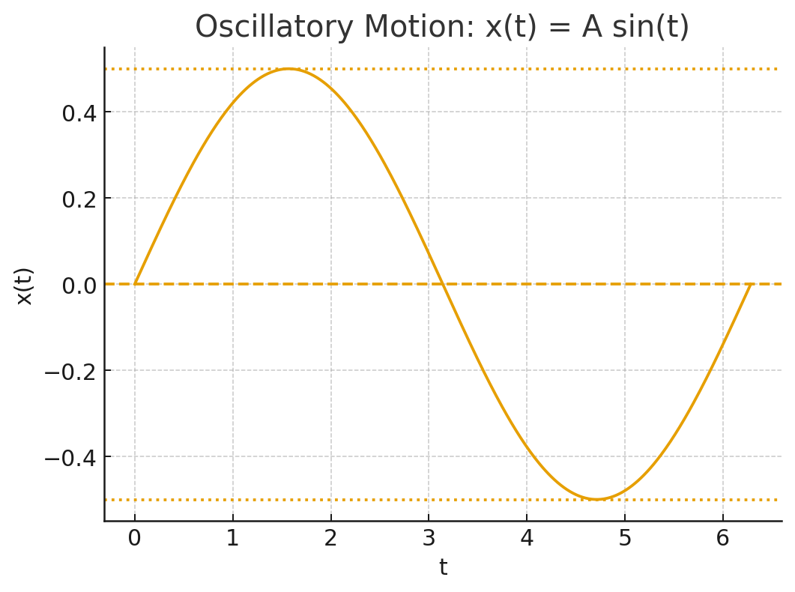
Oscillatory Motion
Equation: x(t) = A sin(ωt)
function sysCall_init() cube = sim.getObjectHandle('Cuboid') end function sysCall_actuation() local t = sim.getSimulationTime() local A = 0.5 local x = A * math.sin(t) -- oscillates ±0.5 sim.setObjectPosition(cube, -1, {x, 0, 0}) end

Slide 17
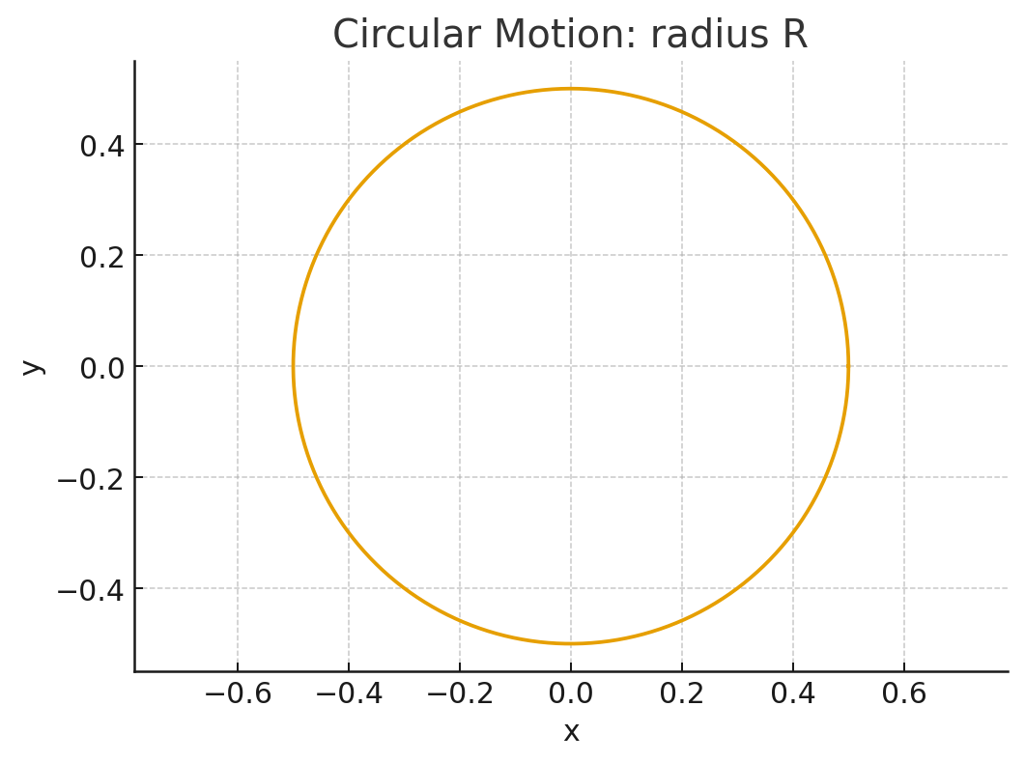
Circular Motion
Equations: x(t) = R cos(ωt), y(t) = R sin(ωt)
function sysCall_init() cube = sim.getObjectHandle('Cuboid') end function sysCall_actuation() local t = sim.getSimulationTime() local R = 0.5 local x = R * math.cos(t) local y = R * math.sin(t) sim.setObjectPosition(cube, -1, {x, y, 0}) end

Slide 18
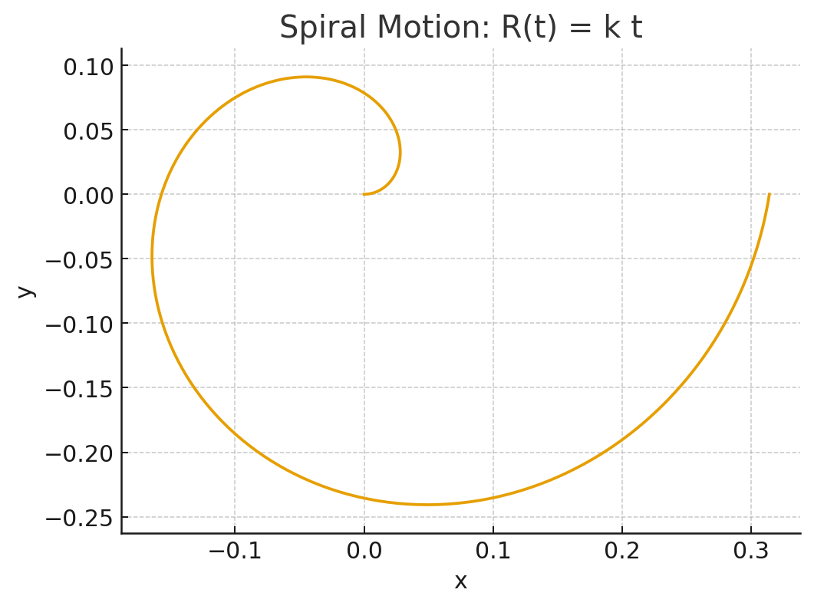
Spline Motion
Equations: x(t) = R(t) cos(ωt), y(t) = R(t) sin(ωt), R(t) = k·t
function sysCall_init() cube = sim.getObjectHandle('Cuboid') end function sysCall_actuation() local t = sim.getSimulationTime() local k = 0.05 local R = k * t local x = R * math.cos(t) local y = R * math.sin(t) sim.setObjectPosition(cube, -1, {x, y, 0}) end

Slide 19



Distance to Goal
Introduce vector subtraction
Compute Euclidean distance between robot and goal
Place Pioneer_p3dx robot
Place a cube at (2,2) as the goal
Attach a Lua script to compute distance

Slide 20
Distance to Goal
function sysCall_init() robot = sim.getObjectHandle('Pioneer_p3dx') goal = sim.getObjectHandle('Cuboid') end function sysCall_actuation() local rPos = sim.getObjectPosition(robot,-1) local gPos = sim.getObjectPosition(goal,-1) local dx = gPos[1] - rPos[1] local dy = gPos[2] - rPos[2] local dist = math.sqrt(dx*dx + dy*dy) print(string.format("Distance to goal: %.2f m", dist)) end

Slide 21



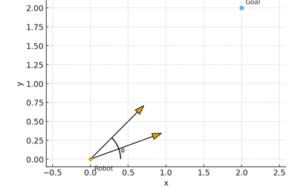

Heading Alignment (Dot Product)
Use dot product to measure robot alignment with goal
Use Pioneer_p3dx at origin
Place goal at (2,2)
Compute dot product b/w heading and goal vector

Slide 22
function sysCall_init() robot = sim.getObjectHandle('Pioneer_p3dx') goal = sim.getObjectHandle('Cuboid') end function sysCall_actuation() local rPos = sim.getObjectPosition(robot,-1) local gPos = sim.getObjectPosition(goal,-1) local ori = sim.getObjectOrientation(robot,-1)
-- ori[1] = alpha (rotation around X-axis) → Roll
-- ori[2] = beta (rotation around Y-axis) → Pitch
-- ori[3] = gamma (rotation around Z-axis) → Yaw local theta = ori[3]
-- Robot heading vector local vx = math.cos(theta) local vy = math.sin(theta) -- Goal direction vector local dx = gPos[1] - rPos[1] local dy = gPos[2] - rPos[2] -- Dot product local dot = vx*dx + vy*dy print(string.format("Dot product = %.2f", dot)) end

Slide 23

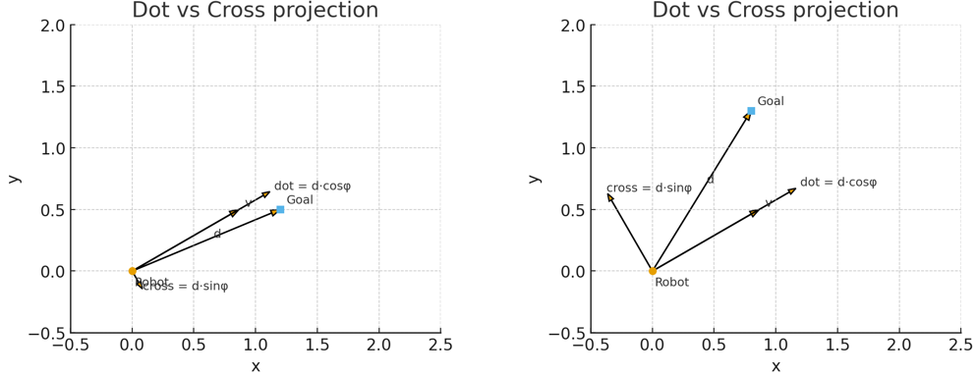

Slide 24
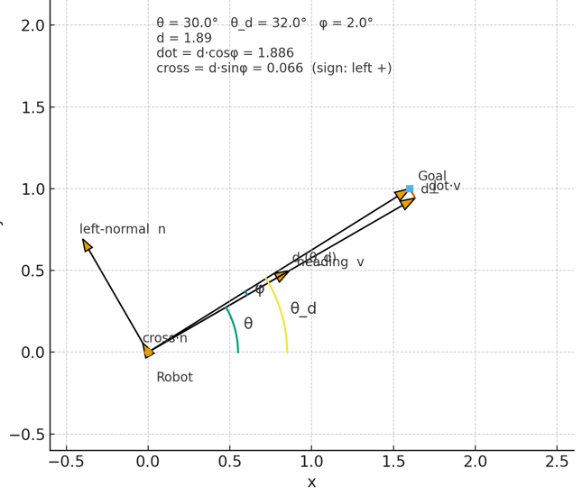

Slide 25
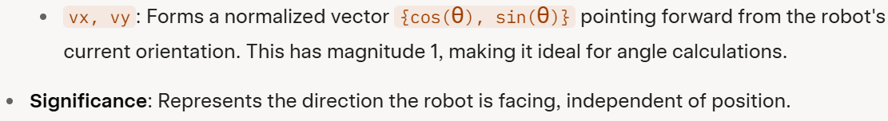
function sysCall_init()
robot = sim.getObjectHandle('Pioneer_p3dx')
goal = sim.getObjectHandle('Cuboid')
end
function sysCall_actuation()
local rPos = sim.getObjectPosition(robot,-1)
local gPos = sim.getObjectPosition(goal,-1)
local theta = sim.getObjectOrientation(robot,-1)[3]
local vx, vy = math.cos(theta), math.sin(theta)
local dx, dy = gPos[1]-rPos[1], gPos[2]-rPos[2] --This vector points from the robot toward the goal
local d = math.sqrt(dx*dx + dy*dy)
local dot = vx*dx + vy*dy -- = d cos(phi)
local cross = vx*dy - vy*dx -- = d sin(phi)
local phi = math.atan2(cross, dot) -- (-pi, pi]
print(string.format("d=%.3f dot=%.6f cross=%.6f cos?=%.3f sin?=%.3f ?=%.1f?",
d, dot, cross, dot/d, cross/d, math.deg(phi)
))
end --Significance: phi is the smallest rotation angle to face the goal exactly:

Slide 26
Unicycle Kinematics
Relate linear and angular velocity to robot motion
Place Pioneer_p3dx
Write Lua to move at constant v
Add ω for circular motion and convert (v, ω) to wheel speeds

Slide 27
function sysCall_init() leftMotor = sim.getObjectHandle('Pioneer_p3dx_leftMotor') rightMotor = sim.getObjectHandle('Pioneer_p3dx_rightMotor') r = 0.0975/2 -- wheel radius L = 0.33 -- axle length end function sysCall_actuation() local v = 0.2 -- linear velocity local w = 0.2 -- angular velocity local vL = (2*v - w*0.33)/(2*0.04875) local vR = (2*v + w*0.33)/(2*0.04875) sim.setJointTargetVelocity(leftMotor, vL) sim.setJointTargetVelocity(rightMotor, vR) end

